Slide 1
Decidable Problems of
Regular Languages

Slide 2




Membership Question
Question:
Given regular language
and string
how can we check if ?
Answer:
Take the DFA that accepts
and check if is accepted

Slide 3


DFA
DFA

Slide 4
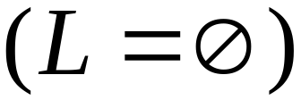
Question:
Given regular language
how can we check
if is empty: ?
Answer:
Take the DFA that accepts
Check if there is any path from
the initial state to an accepting state

Slide 5


DFA
DFA

Slide 6
Question:
Given regular language
how can we check
if is finite?
Answer:
Take the DFA that accepts
Check if there is a walk with cycle
from the initial state to a final state

Slide 7
DFA
is infinite
DFA
is finite

Slide 8


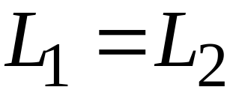
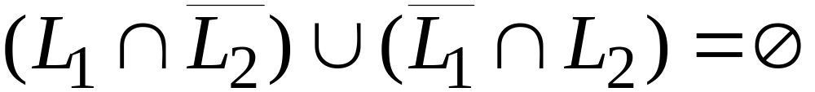
Question:
Given regular languages and
how can we check if ?
Answer:
Find if

Slide 9
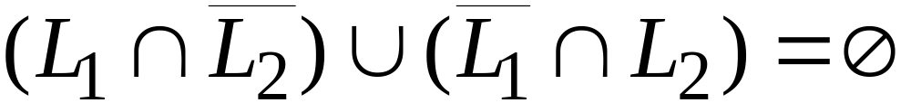
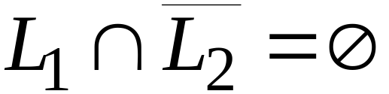
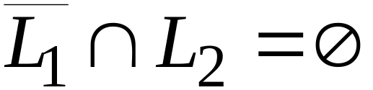


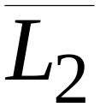
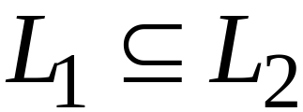
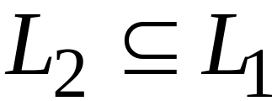
and

Slide 10
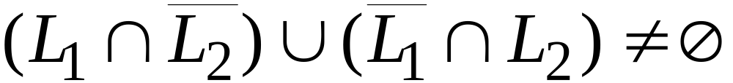
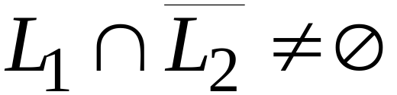
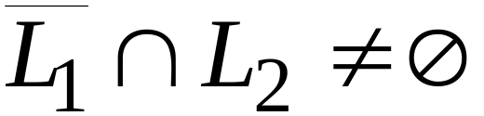
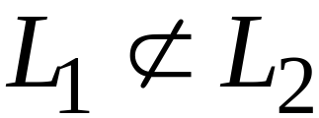
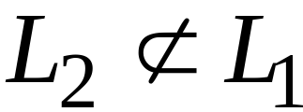
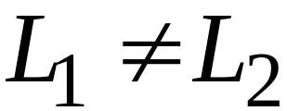
or

Slide 11
Decidable Problems of
Context-Free Languages

Slide 12


Membership Question:
for context-free grammar
find if string
Membership Algorithms:
Parsers
Exhaustive search parser
CYK parsing algorithm

Slide 13
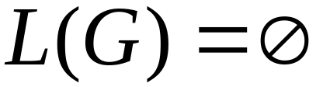

Empty Language Question:
for context-free grammar
find if
Algorithm:
Remove useless variables
Check if start variable is useless

Slide 14
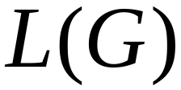

Infinite Language Question:
for context-free grammar
find if is infinite
Algorithm:
1. Remove useless variables
2. Remove unit and productions
3. Create dependency graph for variables
4. If there is a loop in the dependency graph
then the language is infinite

Slide 15
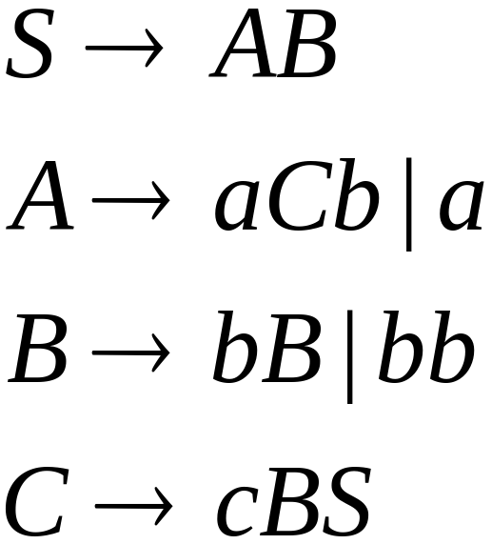




Example:
Infinite language
Dependency graph

Slide 16
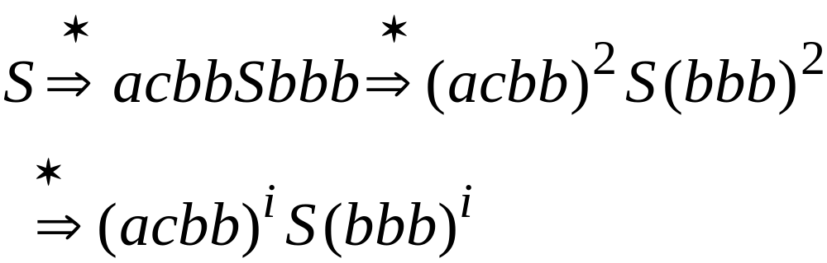

Slide 17
Decidable Languages

Slide 18
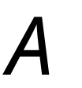


Decidable Languages
Recall that:
A language is decidable,
if there is a Turing machine (decider)
that accepts the language and
halts on every input string
Decision
On Halt:
Turing Machine
YES
Accept
Input
string
Decider for
NO
Reject

Slide 19
A computational problem is decidable
if the corresponding language is decidable
We also say that the problem is solvable

Slide 20
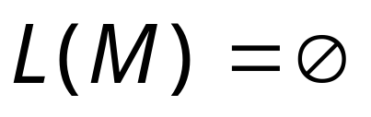

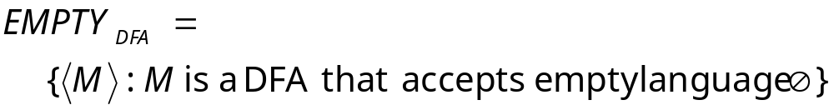
Problem:
Does DFA accept
the empty language ?
Corresponding Language:
(Decidable)
Description of DFA as a string
(For example, we can represent as a
binary string, as we did for Turing machines)

Slide 21
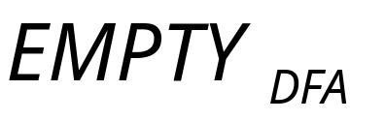
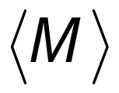

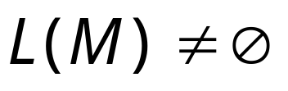

Decider for :
On input :
Determine whether there is a path from
the initial state to any accepting state
DFA
DFA
Decision:
Reject
Accept

Slide 22
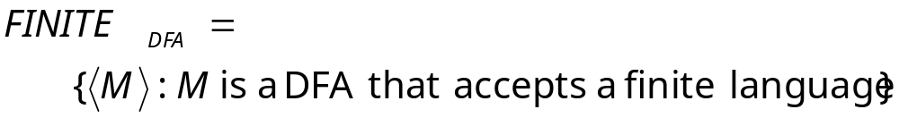
Problem:
Does DFA accept
a finite language?
Corresponding Language:
(Decidable)

Slide 23
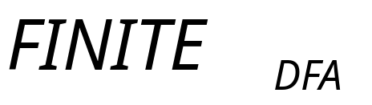
Decider for :
On input :
Check if there is a walk with a cycle
from the initial state to an accepting state
DFA
DFA
infinite
finite
Decision:
Reject
Accept
(NO)
(YES)

Slide 24

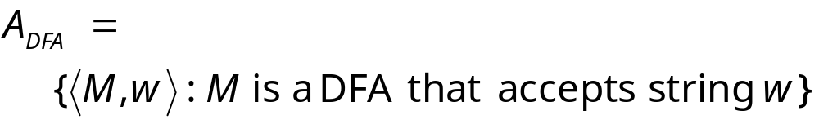
Problem:
Does DFA accept string ?
Corresponding Language:
(Decidable)

Slide 25
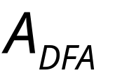
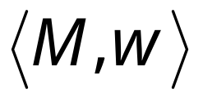
Decider for :
On input string :
Run DFA on input string
If accepts
Then accept (and halt)
Else reject (and halt)

Slide 26
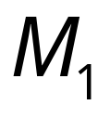
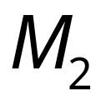
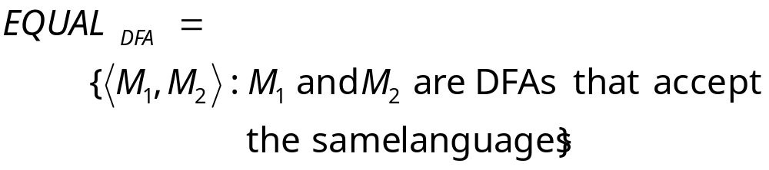
Problem:
Do DFAs and
accept the same language?
Corresponding Language:
(Decidable)

Slide 27
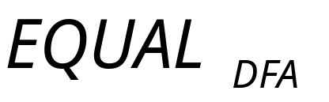
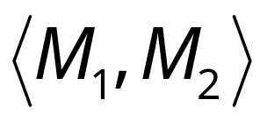
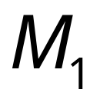
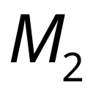

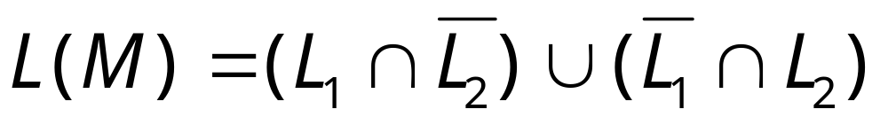
Decider for :
On input :
Let be the language of DFA
Let be the language of DFA
Construct DFA such that:
(combination of DFAs)

Slide 28
and

Slide 29
or

Slide 30
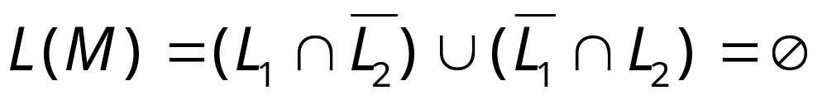
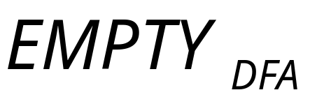
Therefore, we only need
to determine whether
which is a solvable problem for DFAs:

Slide 31
Undecidable Problems
(unsolvable problems)

Slide 32
Undecidable Languages
undecidable language = not decidable language
There is no decider:
there is no Turing Machine
which accepts the language
and makes a decision (halts)
for every input string
(machine may make decision for some input strings)

Slide 33
For an undecidable language,
the corresponding problem is
undecidable (unsolvable):
there is no Turing Machine (Algorithm)
that gives an answer (yes or no)
for every input instance
(answer may be given for some input instances)

Slide 34


We have shown before that there are
undecidable languages:
Turing-Acceptable
Decidable
is Turing-Acceptable and undecidable

Slide 35
We will prove that two particular problems
are unsolvable:
Membership problem
Halting problem

Slide 36



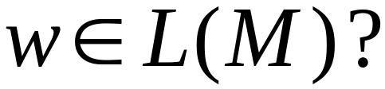
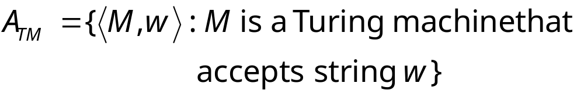
Membership Problem
Input:
Turing Machine
String
Question:
Does accept ?
Corresponding language:

Slide 37
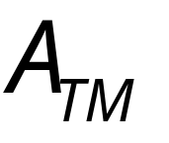
Theorem:
is undecidable
(The membership problem is unsolvable)
Proof:
Basic idea:
We will assume that is decidable;
We will then prove that
every decidable language
is Turing-Acceptable
A contradiction!

Slide 38

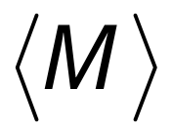
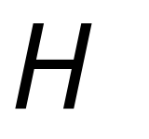
Suppose that is decidable
Input
string
Decider
for
YES
accepts
NO
rejects

Slide 39
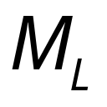
Let be a Turing recognizable language
Let be the Turing Machine that accepts
We will prove that is also decidable:
we will build a decider for

Slide 40
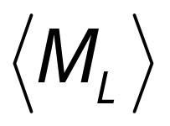

String description of
Decider for
Decider for
YES
accept
(and halt)
accepts ?
NO
reject
Input
string
(and halt)

Slide 41
Therefore,
is decidable
Since is chosen arbitrarily, every Turing-Acceptable language is decidable
But there is a Turing-Acceptable language
which is undecidable
Contradiction!!!!
END OF PROOF

Slide 42
We have shown:
Undecidable
Decidable

Slide 43
We can actually show:
Turing-Acceptable
Decidable

Slide 44
is Turing-Acceptable
Turing machine that accepts :
1. Run on input
2. If accepts
then accept

Slide 45
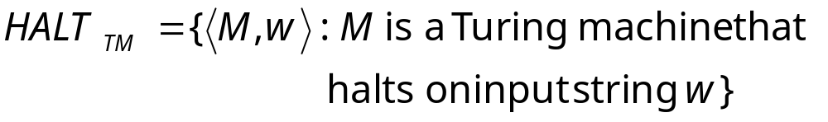
Halting Problem
Input:
Turing Machine
String
Question:
Does halt while
processing input string ?
Corresponding language:

Slide 46
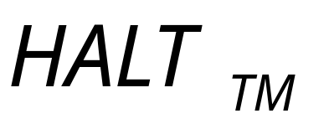
Theorem:
is undecidable
(The halting problem is unsolvable)
Proof:
Basic idea:
Suppose that is decidable;
we will prove that
every decidable language
is also Turing-Acceptable
A contradiction!

Slide 47




Suppose that is decidable
Input
string
halts on
input
YES
Decider for
NO
doesn’t halt
on input

Slide 48
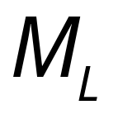
Let be a Turing-Acceptable language
Let be the Turing Machine that accepts
We will prove that is also decidable:
we will build a decider for

Slide 49




Decider for
Decider for
NO
reject
halts on ?
and halt
YES
Input
string
halts
and accepts
accept
Run
with input
and halt
halts
and rejects
reject
and halt

Slide 50
Therefore,
is decidable
Since is chosen arbitrarily, every Turing-Acceptable language is decidable
But there is a Turing-Acceptable language
which is undecidable
Contradiction!!!!
END OF PROOF

Slide 51
An alternative proof
Theorem:
is undecidable
(The halting problem is unsolvable)
Proof:
Basic idea:
Assume for contradiction that
the halting problem is decidable;
we will obtain a contradiction
using a diagonilization technique

Slide 52

Suppose that is decidable
Input
string
Decider
for
YES
halts on
NO
doesn’t
halt on

Slide 53




Looking inside
Decider for
YES
Input string:
halts on ?
NO

Slide 54





Construct machine :
Loop forever
YES
halts on ?
NO
If halts on input Then Loop Forever
Else Halt

Slide 55




Construct machine :
Copy
on tape
If
halts on input
Then loop forever
Else halt

Slide 56





Run with input itself
Copy
on tape
If
halts on input
Then loops forever on input
Else halts on input
CONTRADICTION!!!
END OF PROOF

Slide 57
We have shown:
Undecidable
Decidable

Slide 58
We can actually show:
Turing-Acceptable
Decidable

Slide 59
is Turing-Acceptable
Turing machine that accepts :
1. Run on input
2. If halts on
then accept

